Slide 1

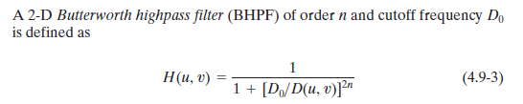
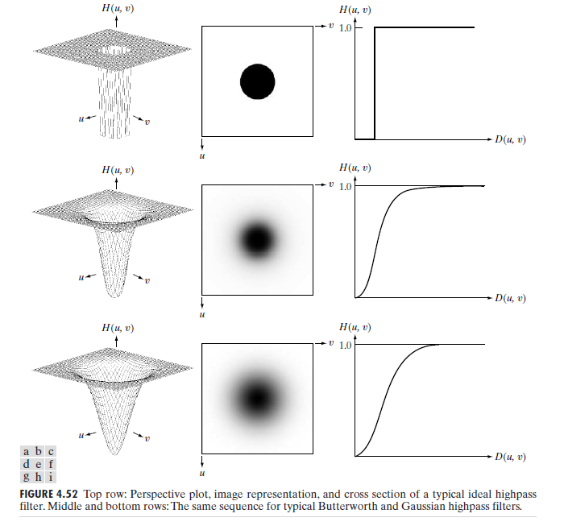
Digital Image Processing
29-butterworth high pass filter
to make an image appear sharper

Slide 2
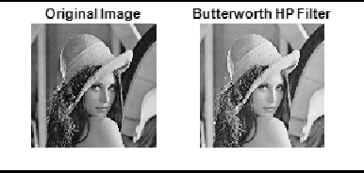
Digital Image Processing
29-butterworth high pass filter
to make an image appear sharper

